Slide 1
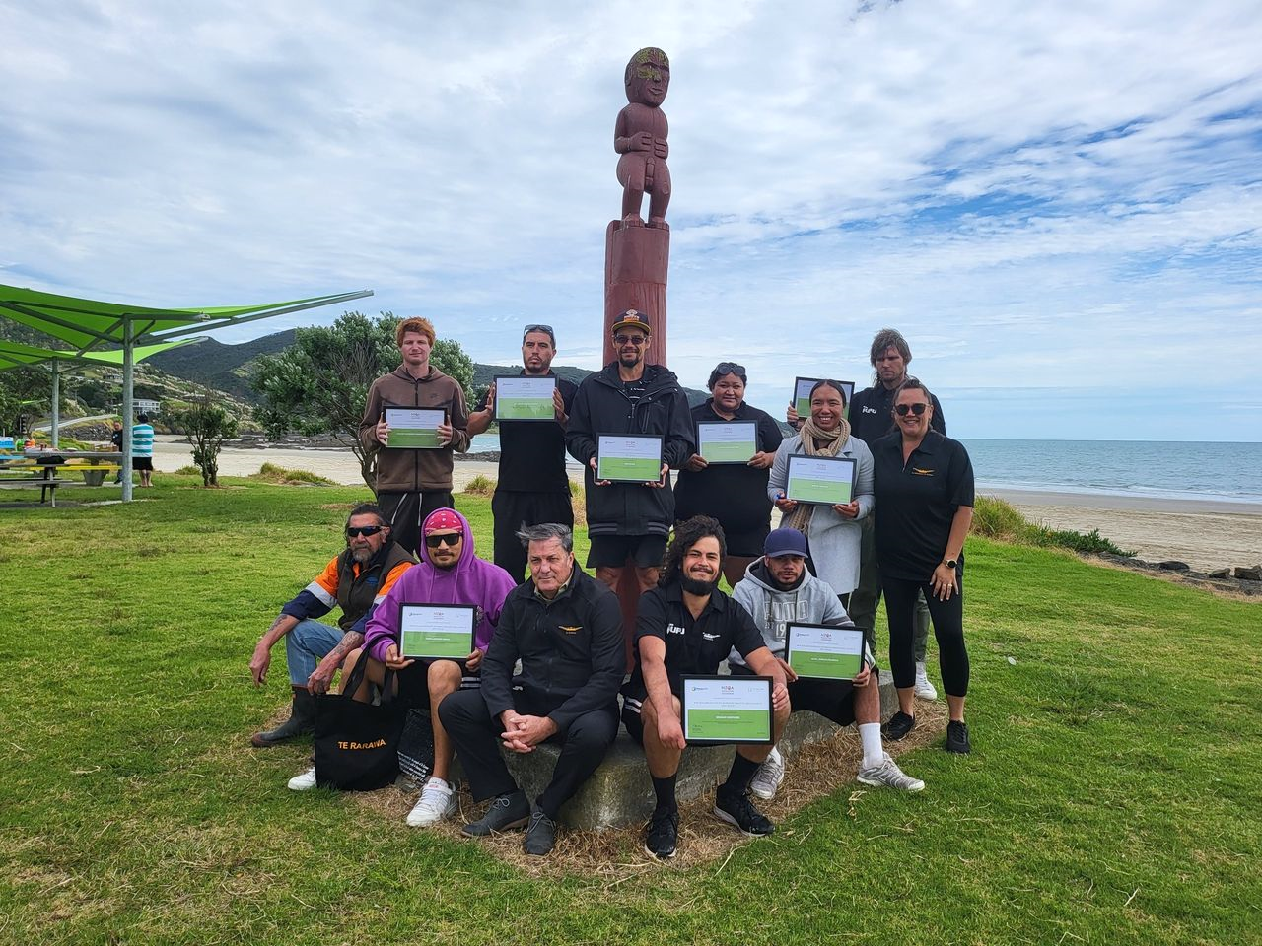
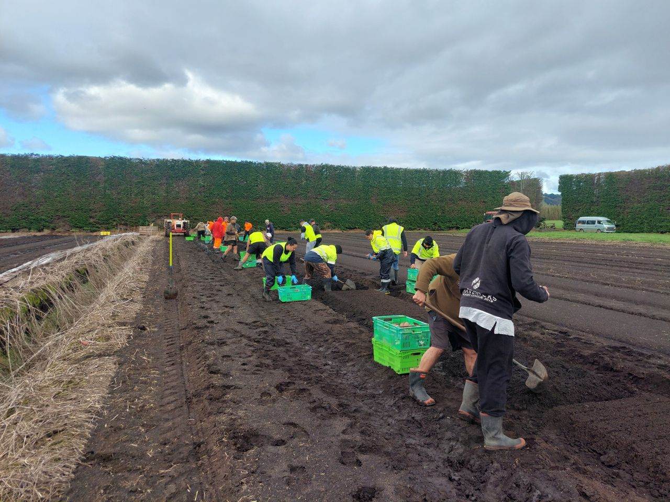



Building
workforce solutions
Responsive
Agile
Transferable

Slide 2
Te Hiku Landscape
Source MSD 2022
Source MOE 2023

Slide 3
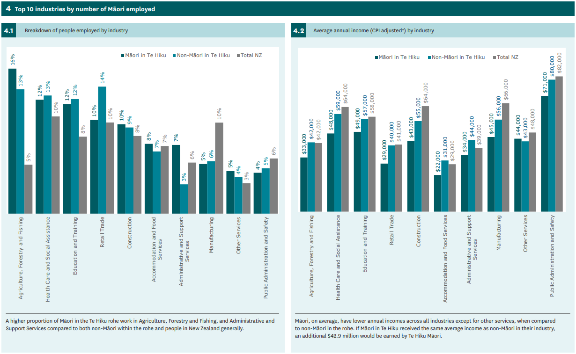
Source MSD 2022

Slide 4
Building
workforce solutions
Responsive
Agile
Transferable
  Customised solutions,
  Learner centric, Sustainable delivery
  Earn Learn,
  Transitions,
  Pathways to progression
  Stackable,
  Cross-creditable,
  Embed core employability skills, Tupu conditions

